Slide 1

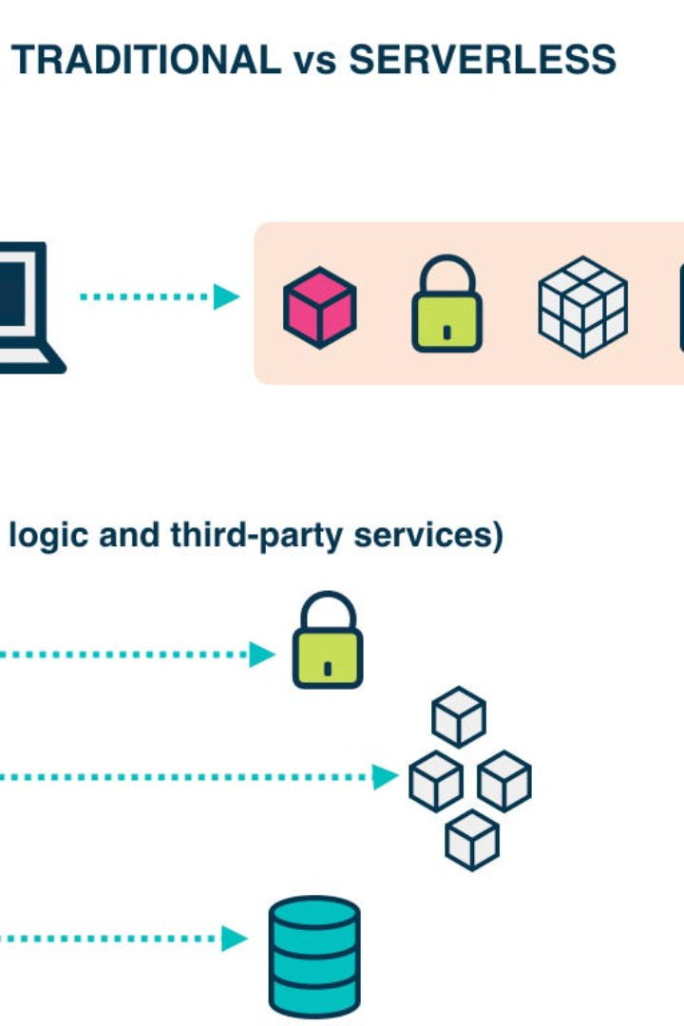
Serverless IoT for Data Processing
Explore the world of Serverless computing and IoT. Discover the benefits, use cases, challenges, and the future potential of this powerful combination.

Slide 2

Introduction
Serverless computing is a cloud computing model that eliminates the need for server management and provisioning. IoT refers to the interconnection of everyday objects to the internet, enabling them to send and receive data. Data processing is a crucial aspect of IoT, enabling actionable insights from massive amounts of collected data.

Slide 3
Benefits of Serverless IoT for Data Processing
Scalability and Flexibility
Cost-effectiveness
Simplified Deployment and Management
With Serverless IoT, you only pay for the resources you use, eliminating the need for upfront hardware and infrastructure costs.
Serverless IoT allows for automatic scaling based on data volume, ensuring efficient processing and response times.
Serverless IoT platforms abstract away server management, enabling developers to focus on data processing logic rather than infrastructure.

Slide 4


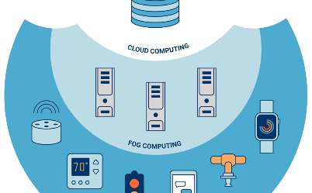
Use Cases of Serverless IoT for Data Processing
Real-time Data Analytics
Machine Learning and Predictive Analytics
Edge Computing
Serverless IoT allows for real-time processing and analysis of sensor data, enabling immediate insights and decision-making.
Serverless IoT enables processing and analysis to be performed closer to the data source at the edge, reducing latency and enabling near real-time response.
Serverless IoT platforms provide the computational power and scalability required for training machine learning models and performing predictive analytics on IoT data.

Slide 5

Challenges and Considerations for Serverless IoT for Data Processing
1
Security and Privacy Concerns
2
Integration with Legacy Systems
With the increased connectivity and data sharing in IoT, ensuring the security and privacy of sensitive data becomes a critical challenge.
Integrating Serverless IoT platforms with existing legacy systems can be complex, requiring careful planning and architectural considerations.
3
Vendor Lock-In
Choosing a Serverless IoT provider locks an organization into that specific platform, potentially limiting flexibility and creating dependency.

Slide 6

Conclusion
Serverless IoT for data processing offers scalability, cost-effectiveness, and simplified management. Use cases include real-time analytics, machine learning, and edge computing. However, challenges exist regarding security, legacy integration, and vendor lock-in. Overall, Serverless IoT has immense potential for transforming data processing in the IoT ecosystem.

